Slide 1
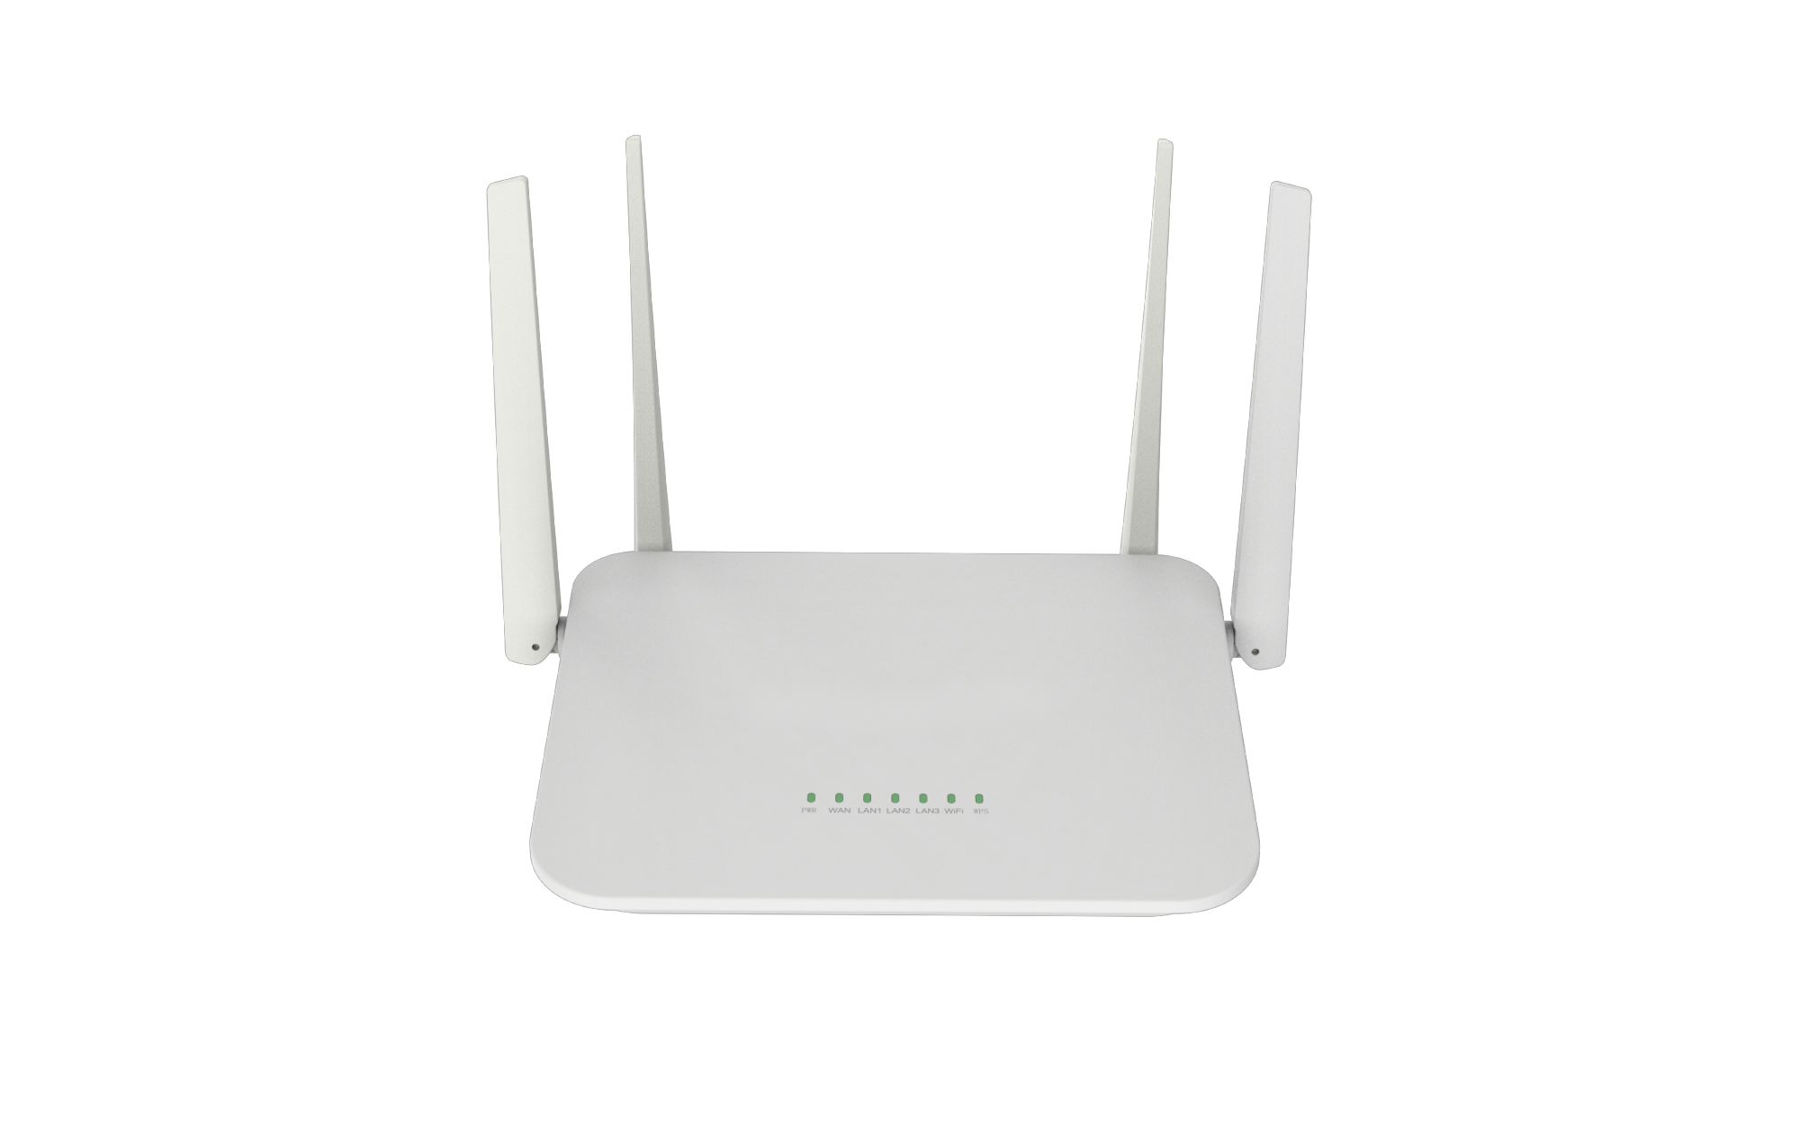
Datasheet|AX3000 Dual Band Gigabit Uplink Wi-Fi6 Router
FR-WR24G-3000D1
Description
FR-WR24G-3000D1 supports ieee 802.11ax standard and is downward compatible with ieee 802.11ac/n/g/b/a, providing wireless data transmission rate up to 3.0gbps, with the characteristics of fast speed, low delay, large capacity, more security and more power saving. Compared with the previous generation of Wi-Fi, the connection rate and the total network capacity are greatly improved. Network delay, channel interference is reduced, data transmission efficiency and connection security are improved. In today's high-density, high congestion network environment, game delay is lower, 4K video experience is smoother, more suitable for a large number of smart home devices access. And support MESH, more concise, convenient and flexible, and improves the traditional network layout.
Major features
Support 802.11ax
High speed data rate up to 3000Mbps
1*GE WAN Port(RJ45), 3*GE LAN Port(RJ45)
Support MU-MIMO and OFDMA
4*5dBi Omnidirectional Antennas
Work temperature from 0 to 40℃
Supports up to 256 users for access (recommended concurrent access terminals: 60)
Hunan Fullriver Information Technology Co., Ltd
Notes:
V 1.00 initial version

Slide 2
Specification
Model | FR-WR24G-3000D1
Chipset | MT7981B+MT7976CN+MT7531AE
CPU | Dual-Core 1.3GHz
RAM | 256MByte(DDR3)
ROM | 128MByte(SPI Nand Flash)
External FEM | NO eFEM
Indicator | SYS,POWER, WAN, LAN1, LAN2, LAN3, LAN4, Wi-Fi
Port | 1*10/100/1000Mbps WAN Port(RJ45) 3*10/100/1000Mbps LAN Port(RJ45) 1*DC Jack
Button | 1*Reset
Antenna | 1*2.4G 5dBi Omnidirectional antenna, 2*5G 5dBi Omnidirectional antenna, 1*2.4G/5G Omnidirectional antenna
Power Supply | 12V1A DC
Dimension | 206*159*36mm
Installation | Desktop
ESD | IEC61000-4-2, Level 3: Contact discharge: ±4kV, Air discharge: ±8kV
Surge | IEC61000-4-5, Common Mode 2kV
Temperature | Work：0~40℃ Storage：-40~70℃
Humidty | Work：10%~90% (RH non-condensing) Storage：5%~95% (RH without non-condensing)
Hunan Fullriver Information Technology Co., Ltd
Hunan Fullriver Information Technology Co., Ltd

Slide 3
Specification
Protocal | 5GHz:IEEE 802.11ax,IEEE 802.11ac,IEEE 802.11n,IEEE 802.11a 2.4GHz:IEEE 802.11ax,IEEE 802.11ac,IEEE 802.11n,IEEE 802.11g,IEEE 802.11b
Work Band | 2.4GHz & 5GHz
Wi-Fi Speed | 2.4GHz: Up to 574Mbps (2T2R) 5GHz: Up to 2402Mbps (2T2R)
Modulation | IEEE 802.11b:CCK, QPSK, BPSK IEEE 802.11g/a:OFDM IEEE 802.11n:QPSK, BPSK, 16QAM, 64QAM IEEE 802.11ac:BPSK, QPSK, 16QAM, 64QAM, 256QAM IEEE 802.11ax:BPSK, QPSK, 16QAM, 64QAM, 256QAM, 1024QAM
2.4G | Mode | Rate | Power(dBm)
 | 802.11b | 1M | 21±2dBm
 |  | 11M | 21±2dBm
 | 802.11g | 6M | 21±2dBm
 |  | 54M | 19±2dBm
 | 802.11n HT20 | MCS0 | 20±2dBm
 |  | MCS7 | 18±2dBm
 | 802.11n HT40 | MCS0 | 20±2dBm
 |  | MCS7 | 18±2dBm
 | 802.11ax HE-SU20 | MCS0 | 20±2dBm
 |  | MCS11 | 16±2dBm
 | 802.11ax HE-SU40 | MCS0 | 20±2dBm
 |  | MCS11 | 16±2dBm
5G | Mode | Rate | Power(dBm)
 | 802.11a | 6M | 22±2dBm
 |  | 54M | 19±2dBm
 | 802.11n HT20 | MCS0 | 22±2dBm
 |  | MCS7 | 19±2dBm
 | 802.11n HT40 | MCS0 | 22±2dBm
 |  | MCS7 | 19±2dBm
 | 802.11ac VHT20 | MCS0 | 22±2dBm
 |  | MCS8 | 18±2dBm
 | 802.11ac VHT40 | MCS0 | 22±2dBm
 |  | MCS9 | 18±2dBm
 | 802.11ac VHT80 | MCS0 | 22±2dBm
 |  | MCS9 | 18±2dBm
 | 802.11ax HE-SU20
 |  | MCS11 | 17±2dBm
 | 802.11ax HE-SU40
 |  | MCS11 | 17±2dBm
 | 802.11ax HE-SU80
 |  | MCS11 | 17±2dBm
Hunan Fullriver Information Technology Co., Ltd
Hunan Fullriver Information Technology Co., Ltd

Slide 4
Specification
2.4G | Mode | Rate | RX Sensitivity(dBm)
 | 802.11b | 1M | -97dBm
 |  | 11M | -88dBm
 | 802.11g | 6M | -94dBm
 |  | 54M | -76dBm
 | 802.11n HT20 | MCS0 | -93dBm
 |  | MCS7 | -73dBm
 | 802.11n HT40 | MCS0 | -90dBm
 |  | MCS7 | -71dBm
 | 802.11ax HE-SU20 | MCS0 | -91dBm
 |  | MCS11 | -66dBm
 | 802.11ax HE-SU40 | MCS0 | -91dBm
 |  | MCS11 | -61dBm
5G | Mode | Rate | RX Sensitivity(dBm)
 | 802.11a | 6M | -93dBm
 |  | 54M | -75dBm
 | 802.11n HT20 | MCS0 | -92dBm
 |  | MCS7 | -69dBm
 | 802.11n HT40 | MCS0 | -89dBm
 |  | MCS7 | -64dBm
 | 802.11ac VHT20 | MCS0 | -92dBm
 |  | MCS8 | -68dBm
 | 802.11ac VHT40 | MCS0 | -89dBm
 |  | MCS9 | -64dBm
 | 802.11ac VHT80 | MCS0 | -86dBm
 |  | MCS9 | -61dBm
 | 802.11ax HE-SU20
 |  | MCS11 | -63dBm
 | 802.11ax HE-SU40
 |  | MCS11 | -61dBm
 | 802.11ax HE-SU80
 |  | MCS11 | -57dBm
Hunan Fullriver Information Technology Co., Ltd
Hunan Fullriver Information Technology Co., Ltd

Slide 5
Specification
5G | Mode | Rate | RX Sensitivity(dBm)
 | 802.11a | 6M | -94dBm
 |  | 54M | -76dBm
 | 802.11n HT20 | MCS0 | -93dBm
 |  | MCS7 | -69dBm
 | 802.11n HT40 | MCS0 | -90dBm
 |  | MCS7 | -67dBm
 | 802.11ac VHT20 | MCS0 | -93dBm
 |  | MCS8 | -69dBm
 | 802.11ac VHT40 | MCS0 | -90dBm
 |  | MCS9 | -66dBm
 | 802.11ac VHT80 | MCS0 | -87dBm
 |  | MCS9 | -61dBm
 | 802.11ac VHT160 | MCS0 | -84dBm
 |  | MCS9 | -58dBm
 | 802.11ax HE-SU20 | MCS0 | -93dBm
 |  | MCS11 | -64dBm
 | 802.11ax HE-SU40 | MCS0 | -91dBm
 |  | MCS11 | -61dBm
 | 802.11ax HE-SU80 | MCS0 | -88dBm
 |  | MCS11 | -58dBm
 | 802.11ax HE-SU160 | MCS0 | -85dBm
 |  | MCS1 | -55dBm
 | 802.11be EHT20 | MCS0 | -93dBm
 |  | MCS13 | -57dBm
 | 802.11be EHT40 | MCS0 | -91dBm
 |  | MCS13 | -54.5dBm
 | 802.11be EHT80 | MCS0 | -88dBm
 |  | MCS13 | -51.5dBm
 | 802.11be EHT160 | MCS0 | -85dBm
 |  | MCS13 | -48.5dBm
Hunan Fullriver Information Technology Co., Ltd
Hunan Fullriver Information Technology Co., Ltd

