Slide 1
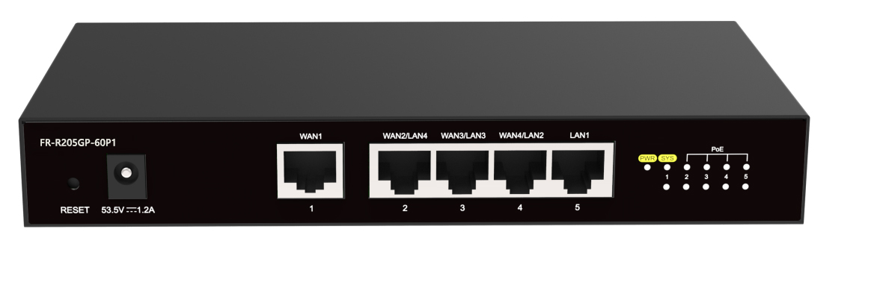
Datasheet|5-Port Gigabit AC+PoE Router(4-Port PoE)
FR-R205GP-60P1
Description
FR-R205GP-60P1 is an integrated Gigabit router which has PoE function, It could solve No-Wifi situation for Large-sized apartment or Complex layout apartment when it just one has a router . It is easy to install. Simple to set up. It is designed by arranging wireless AP panel in each room . The router uniformly allocates IP address and PoE power supply, It does not fear the wall barriers and can eliminate the covering corners. It can seamless roam easily .can ensure the equipment run stably for a long time. It can provide quality, high-speed, stable wireless network coverage for home users, small and micro enterprises.
Major features
５*10/100M/1000M RJ45 Port
LAN-WAN rate up to 800Mbps
4*Port support PSE out(802.3at/af)，Highest PSE Power 60W
Carrying 32 APs in centralized forwarding mode and 128 APs in local forwarding mode
Recommend 100 access terminals
Recommended working temperature range of 0~45 ℃
Hunan Fullriver Information Technology Co., Ltd
Notes:
V 1.00 initial version

Slide 2
Specification
Model | FR-R205GP-60P1
Chipset | MT7621A+IP804AR
CPU | Dual Core 880MHz
RAM | 256MByte(DDR3)
ROM | 32MByte(SPI Nor Flash)
Indicator | SYS, Power, Link/ACT, PSE
Port | 1*10/100/1000Mbps WAN Port(RJ45) 4*10/100/1000Mbps LAN Port(RJ45) 1*DC JACK
Button | 1*Reset
Power Supply | 53.5V/1.2A adapter
Power Pin Assignment | 1/2(+),3/6(-)
PoE Budget | 60W
Dimension | 190*100*28mm
Installation | Desktop, Wall-Plate
ESD | IEC61000-4-2, Level 3: Contact discharge: ±6kV, Air discharge: ±8kV
Surge | IEC61000-4-5, Common Mode 4kV, Differential Mode 1KV
Temperature | Work：0~45℃ Storage：-40~70℃
Humidty | Work：10%~90% (RH non-condensing) Storage：5%~95% (RH without non-condensing)
Hunan Fullriver Information Technology Co., Ltd
Hunan Fullriver Information Technology Co., Ltd

Slide 3
Specification
Software Specification
Deployment Gateway (centralized forwarding) Access Controller (Local forwarding) | Network Setting Dynamic IP、Static IP、PPPoE IPv6 IPv4/IPv6 DHCP Static-NAT、NAPT、Port Fowarding VLAN Setting Policy Routing | Authentication Portal Radius Message User management and billing Internet IP authentication free
AP Management Load Balancing Seamless Roaming Scheduled AP restart/upgrade User Isolation AP discovered Black List | Security Packet Attack Prevention Flood Attack Prevention URPF Attack Prevention IPv4/IPv6 Black List IP/MAC/URL Filter | VPN IPsec L2TP PPTP GRE EOIP
Management WEB Telnet SSH TR069
Hunan Fullriver Information Technology Co., Ltd
Hunan Fullriver Information Technology Co., Ltd

