Slide 1
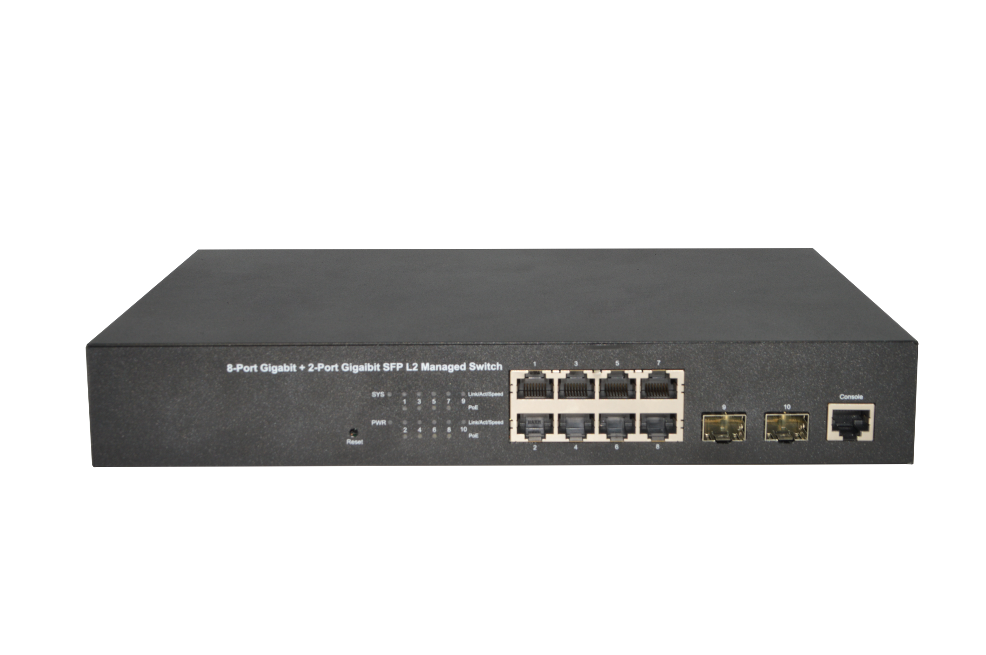
Datasheet|8 GE +2 SFP L2 Managed PoE Switch
FR-S3110GS-140P2
Description
FR-S3110GS-140P2 is a high performance the second managed gigabit switch. Provides eight 10/100/1000Mbps self-adaption RJ45 ports, plus two gigabit SFP ports, it can be used to link bandwidth higher upstream equipment. Support VLAN ACL based on port, easily implement network monitoring, traffic regulation, priority tag and traffic control. Support traditional STP/RSTP/MSTP 2 link protection technology; greatly improve the ability of fault tolerance, redundancy backup to ensure the stable operation of the network. Support ACL control based on the time, easy control the access time accurately. Support 802.1x authentication based on the port and MAC, easily set user access. Perfect QOS strategy and plenty of VLAN function.PoE ports can automatically detect and supply power with those IEEE 802.3at/af compliant Powered Devices (PD). In this situation, the electrical power is transmitted along with data in one single cable allowing you to expand your network where there are no power lines or outlets, where you wish to fix devices such as AP, IP Cameras or IP Phones, etc
Features
Supports PoE power up to 30W for each PoE port, total power up to 140W for all PoE ports
Supports IEEE802.3x flow control for Full-duplex Mode and backpressure for Half-duplex Mode
Supports MAC address auto-learning and auto-aging
Store and forward mode operates
Support SNMP/RMON/TELENT
Support IEEE802.1p Priority Queues
Support Storm Control
Support QoS、Port Mirroring、Link Aggregation Protocol
LED indicators for monitoring PSE, Link/Activity/Speed
Web-based Management Support
湖南恒茂高科股份有限公司
HUNAN FULLRIVER HIGH TECHNOLOGY CO.,LTD.
Notes:
V 1.00 initial version

Slide 2
Specification
Model |  | FR-S3110GS-140P2
Chipset |  | RTL8380M+IP808AR
Standards |  | IEEE 802.3i，IEEE 802.3u，IEEE 802.3ab，IEEE802.3x，IEEE802.3z，IEEE802.3ad，IEEE802.1P，IEEE802.1Q IEEE802.3at,IEEE802.3af
Ports |  | 8 x 10/100/1000Mbps ports 2 x 1000Mbps SFP ports 1 x Console port
Network Media(Cable) |  | 10Base-T: UTP category 3, 4, 5 cable (maximum 100m) 100Base-Tx: UTP category 5, 5e cable (maximum 100m) 1000Base-T: UTP category 5e, 6 cable (maximum 100m) 1000Base-X: MMF,SMF
Transfer Method |  | Store-and-Forward
MAC Address Table |  | 8K
Switching Capacity |  | 20Gbps
Packet Forwarding Rate |  | 14.88Mpps
Packet Buffer |  | 4.1Mbits
Jumbo Frame |  | 9KBytes
PoE Ports(RJ45) |  | 1-8 ports compliant with 802.3at/af
Power Pin Assignment |  | 1/2(+),3/6(-)
PoE Budget |  | 140W
LED indicators | Per Device | SYS&Mode : Green
 | Per-Port | RJ45/SFP+：Green
 |  | PoE：Orange
Power Supply |  | AC 100~240V, 50/60HZ, 150W internal power
Dimensions（L×W×H） |  | 280*180*44mm
ESD |  | IEC61000-4-2, Level 3: Contact discharge: ±6kV, Air discharge: ±8kV
Surge |  | IEC61000-4-5, RJ45 Common Mode 6kV Power Common Mode 4kV Power Differential mode 2kV
Environment |  | Operating Temperature: 0℃ ~ 45℃ Storage Temperature: -40℃ ~70℃ Operating Humidity: 10%~90% non-condensing Storage humidity: 5%~90% non-condensing
湖南恒茂科股份有限公司
HUNAN FULLRIVER HIGH TECHNOLOGY CO.,LTD.

Slide 3
Software
Port properties | Support system LED、Port configuration、Port statistics Support MTU、DDM、VCT
Management and maintenance | Support System information、user management Support SSH Support Telnet-Server、Telnet-Client、Telnet6-Server、Telnet6-Client Support ping、ping6 Support Tracert、tracert6 Support WEB management、SNMP、RMON Support Manage IP restrictions、Manage timeouts、Reboot
VLAN | Support 802.1Q Support vlan-mac、vlan-protocol、vlan-subnet Support voice vlan Support QinQ Support vlan-swap、vlan-translate、GVRP
Forwarding control | Support Mac address management Support flow-control、BandWidth-Control、DST-Control、SRC-Control、ErrorPacket-Control
Mirror | Support mirror、remote_mirror、ERSPAN
security features | Support Port isolation、storm-control、port-security、pppoeplus Support MUSER Support 802.1X Support arp anti-flood、arp anti-spoofing Support Prevent DOS attacks Support Discard-BPDU、shutdown-control Support dhcp anti-attack、ip-source-guard
System reliability | Support LACP、RSTP、MSTP、STP、LBD、ERPS、EAPS、FLink、Mlink、PVST
DHCP | Support dhcp-snooping、DHCPv6-Snooping、dhcp-relay、dhcp-server Support option82、option60、Option18、Option37
L2 multicast | Support IGMP-Snooping、MLD-Snooping、GMRP Support Static multicast
System alarm | Support syslog、cpu alarm、port alarm
Link detection | Support LLDP、UDLD
Time management | Support Static state time、SNTP-Client
OAM | Support EFM、CFM
ARP | Support ARP、ND
IPv4 | Support Ordinary VLAN interface、SuperVLAN interface Support Static routing
IPv6 | Support Ordinary VLAN interface、SuperVLAN interface Support Static routing
HUNAN FULLRIVER HIGH TECHNOLOGY CO.,LTD.

